Slide 1
Capstone Project Amazon Product Review Analysis
Prime Pantry Data
Under Guidance Of
Dr. Amit Kumar
Presented By :
Sania Inamdar Subhranil Mondal Tejaswini Dhangar Yash Singh

Slide 2
Business Problem
Sentiment analysis enables businesses to precisely identify positive , neutral & negative attitudes about Amazon Prime Pantry products or services and take appropriate action. Businesses can gain insights by reading millions of comments and opinions made on Amazon.
Business needs :
Customer segmentation to find out which group of customers business should focus on.
Sentiment prediction of upcoming reviews.
Segmentation of product to find out which group of products are performing best.
Forecasting of sentiments to obtain the scenario of customer sentiments in future.
Objective: Customer Retention and Sentiment Forecasting

Slide 3
Data Preparation Steps
Data Source : The data we have to download was 5-core and metadata from the Base dataset
Amazon review data
Data cleaning process:
1
2
3
4
Dropping Non-Required Column
Checking Null Values
Data Cleaning
Filling Null Values
Columns contains URLs.
Columns that was blank totally
Checking null values of each column
Cleaning each columns as per requirement.
Filling null values by suitable methods.
Preprocessing Analysis

Slide 4
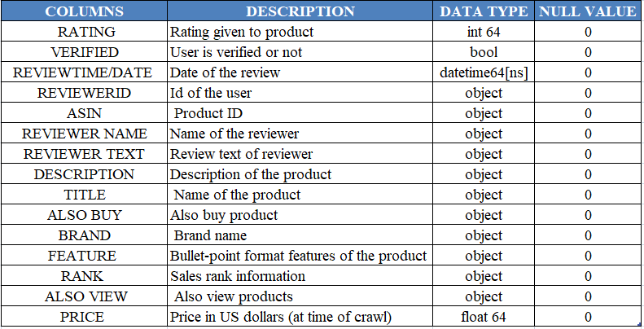
Description of the Dataset
After Preprocessing size of dataset (137769, 15)

Slide 5
EXPLORATORY DATA ANALYSIS

Slide 6
Text Preprocessing & Sentiment Analysis
Text Cleaning
Text Processing
Sentiment
We are removing
Non-word characters
White spaces
Digits
Punctuations
Stop words
From the review_text column.
Lemmatization
List to string conversion
Storing the preprocessed data into clean_text column.
We are using TextBlob to calculate polarity of each reviews.
Polarity >= 0.5 ⟹ Positive
Polarity 0 - 0.5 ⟹ Neutral
Polarity < 0 ⟹ Negative

Slide 7
Classification Analysis
Objective: To build best supervised ML model to predict the sentiments of unseen reviews.
Classification Analysis
1
2
3
4
5
6
Gathering Data
Splitting Data
Vectorization
Model Building & Evaluation
Hyper Parameter Tuning
Prediction
Defining target column & Feature column.
Splitting the data into train test split at 70:30 ratio
Converting text data into numeric by vectorization methods.
Build 4 model to obtain the best evaluated model for the data
Hyper Parameter Tuning of best model to improve the model performance.
Predicting the unseen data by best model to observe the performance.

Slide 8
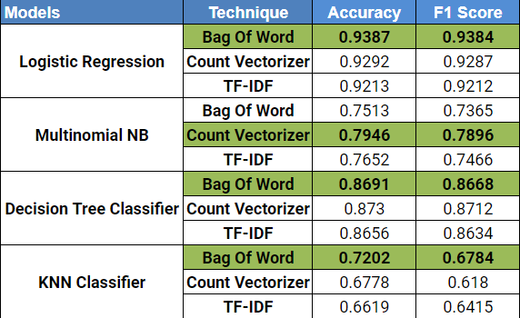
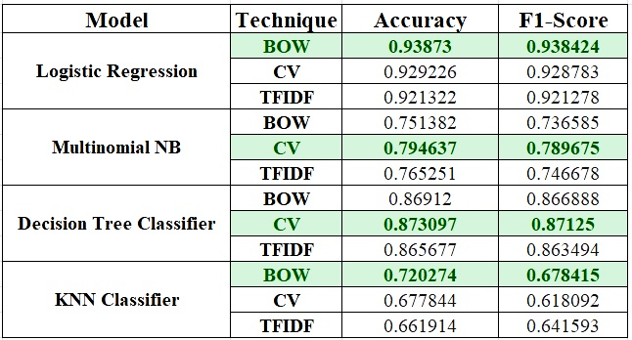
Model Summary
Model Used : Logistic Regression | Multinomial Naive Bayes | Decision Tree | K Nearest Neighbour
Limitations of Vectorization Techniques Used:
Bag Of Words:
It doesn’t consider the order of the words .So meaning of the sentence might get change.
Count-Vectoriser:
It considers the supporting verbs, articles such as ‘a, the’.So the weightage of the vector isn’t appropriate at all.
TF-IDF:
Till now it is the best vectorization technique.

Slide 9
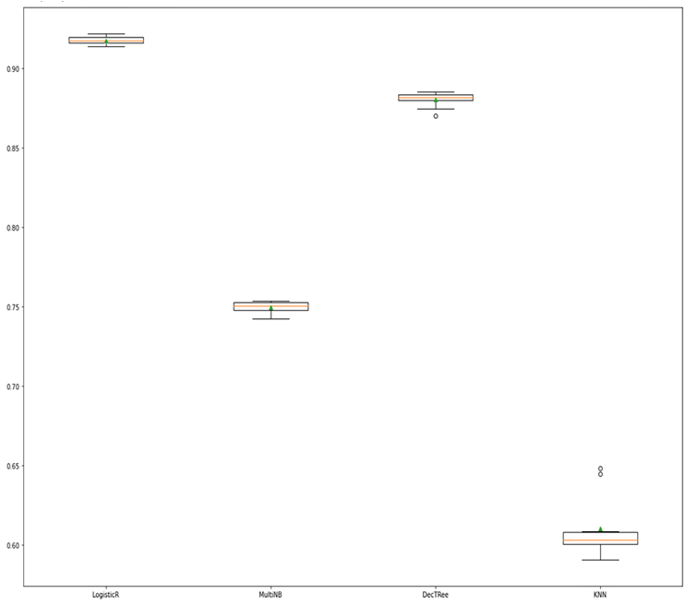
Tf-Idf Vectorization method with Cross Validation
Cross-validation is a technique in which we train our model using the subset of the data-set and then evaluate using the complementary subset of the data-set.
From the visuals we can say that the Logistic Regression model gets the higher F1 score (91.8%) among all the models.
F1-Score
Logistic R Multinomial NB Decision Tree KNN

Slide 10
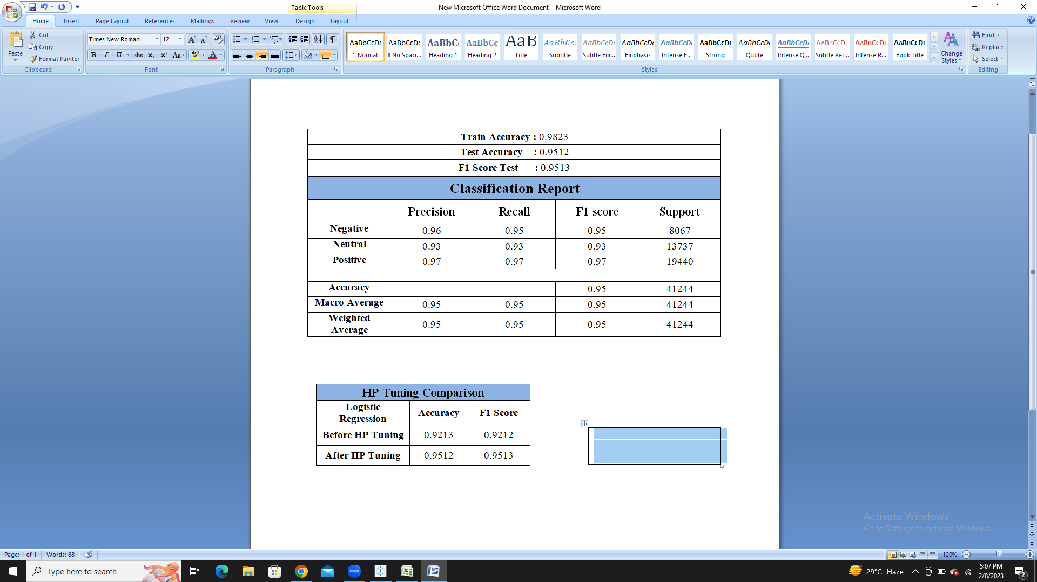
Hyperparameter Tuning
According to model evaluation Logistic Regression gives us better accuracy & F1 score compared to others.
Considering L1,L2 penalties and logarithmically spaced C values.
We are applying Grid search cv on this.

Slide 11
Prediction on Random Data
After hyper parameter tuning as our model getting 95% accuracy. So here we are testing our model on random data.
Review 1 : Taste not to be believed. Buy a box for my office every week Prediction 1: Negative
Review 2 : These are delicious and healthy snacks! I with they were more affordable because they're really tasty and convenient. I purchased these because they're lower in sugar than many other brands and really enjoy them. Prediction 2 : Positive
Review 3 : Excellent. Only complaint is they stick to the wrapper and are hard to remove. But taste and nutrition are great. Prediction 3 : Neutral

Slide 12
Clustering Analysis
Objective: The main objective of clustering is to identify the products which are performing best, average and worst.
Clustering Analysis
1
2
3
4
Feature Selection
Cluster Selection
Model Building
Model Evaluation
Selecting the columns for cluster formation
Selecting the number of clusters by Elbow curve, Dendrogram
Building 2 Models to obtain the best clusters
Evaluating best model by cluster formation on Scatter plot

Slide 13
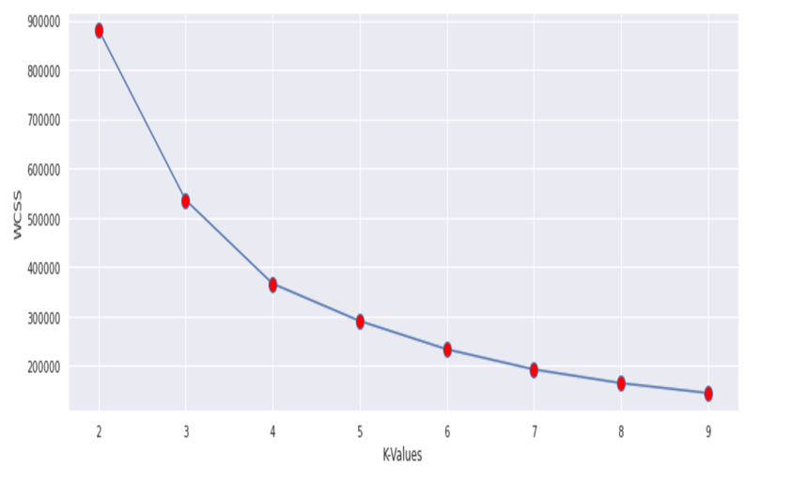
Clustering Analysis (Contd.)
Feature Selection:
Rating
Price
Polarity
Elbow method: To find the optimal value for k
Silhouette score
K-Means | 0.5904
Hierarchical -Agglomerative | 0.4408
WCSS
KValues

Slide 14
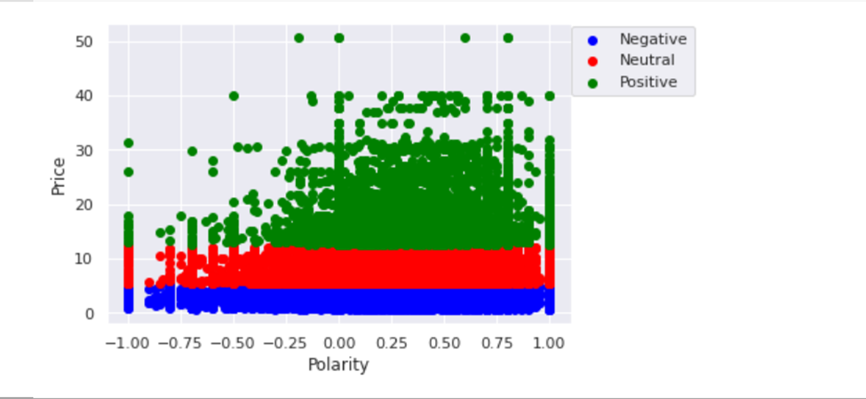
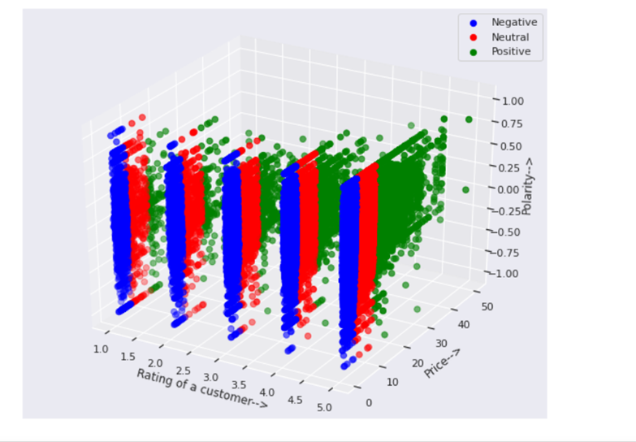
Evaluation of Clustering
Getting Optimum Clusters By K-Means
From 2D plotting we can’t interpret properly.
By 3D plotting now we can Interpret the clusters properly.

Slide 15
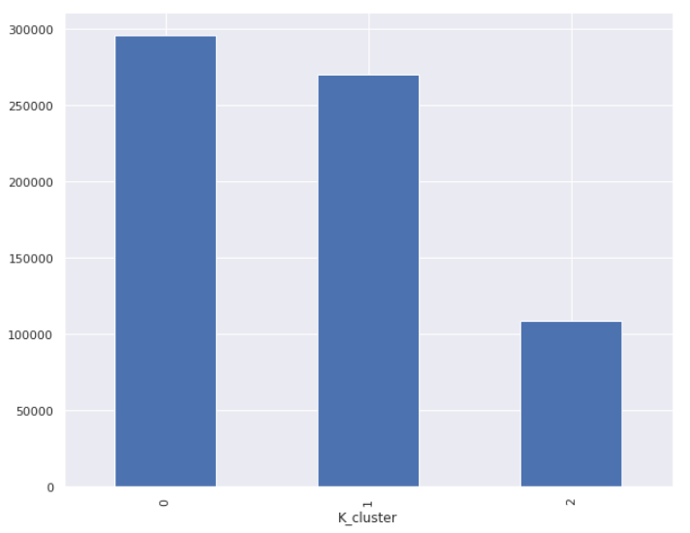
Insights of Clustering
The clusters 0 represents products with positive review and having maximum sales.
The cluster 1 represents products with neutral reviews.
Cluster 2 represents products with negative reviews having lesser sales compare to other two clusters.
So, we need to focus on products belonging to cluster 2 such as Tapatio, Ancient Harvest. So we can increase the quality of those products.
Cluster 0 = Best
Cluster 1 = Average
Cluster 2 = Worst

Slide 16
Brand Recommendation (According to Clustering)
Product Cluster | Brands | Sales ($)
Best | Quaker Barilla Progresso Method Glad
Average | Planters Frito Lay Downy Hostess Viva Labs
Worst | Tide Bounty Happy Belly Finish Bounce
2,95,844
2,70,450
1,08,483

Slide 17
Time Series Analysis
Objectives: Through Time Series Analysis we are going to predict/forecast the future sentiment of the customers shopping on Amazon Prime Pantry.
1
2
3
4
5
6
Splitting Sentiment
Resampling
Decomposition
Check Stationarity
Time Series Model
Sentiment Forecasting
Split overall sentiments into 3 different column Positive,Neutral,Negative
Resampling the data Quarterly to get the continuity in the data
To visualize time series components
Checking the stationarity of the data by ADF test
ARIMA, SARIMA models on Positive, Neutral, Negative Sentiments
On the best model we will forecast the upcoming sentiments
Time Series Analysis

Slide 18
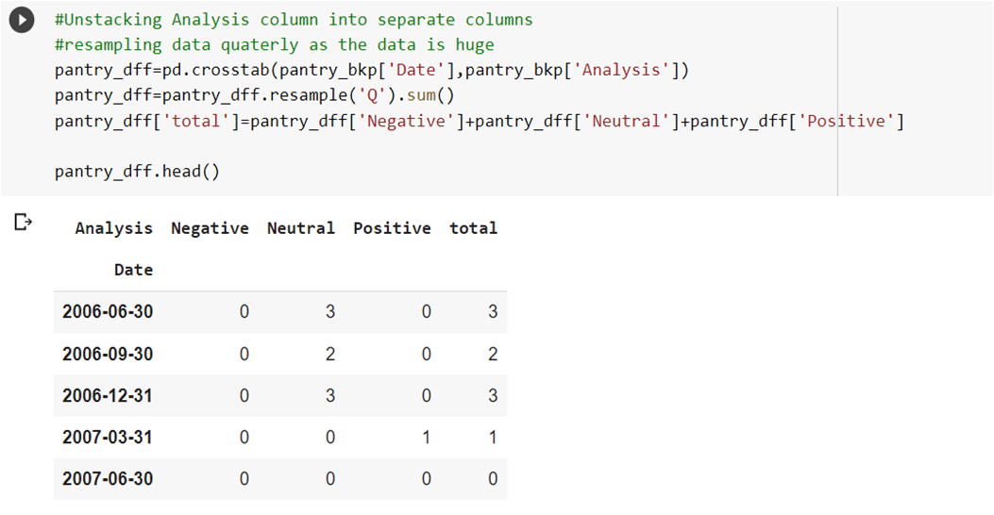
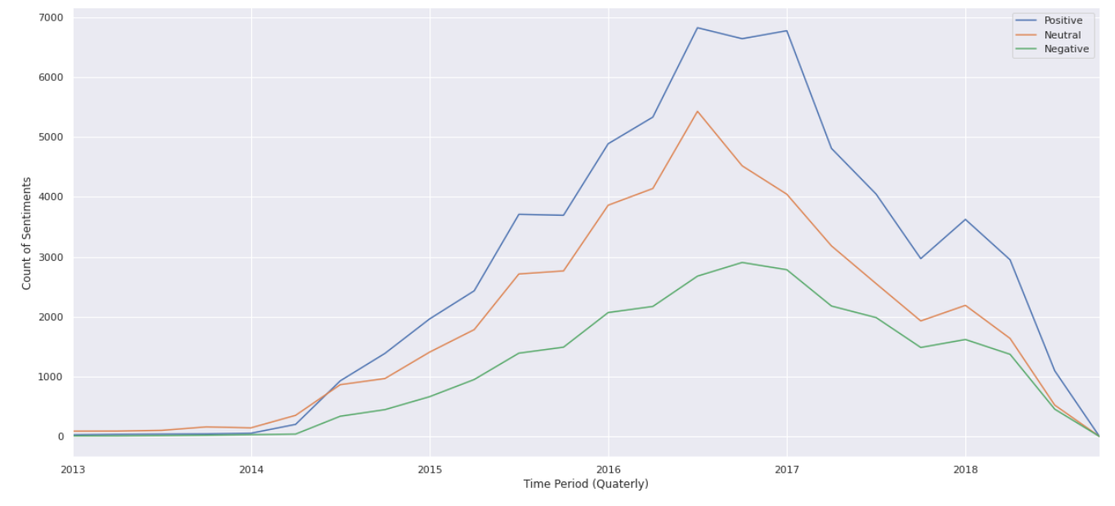
Time Series Analysis(Contd.)
Data Understanding :
Split overall sentiments into 3 different column Positive,Neutral,Negative.
Plot of Sentiments:
Here we can see the various sentiment are plotted over time period from 2012-2018.

Slide 19
Methodology
Pass
Picking best values of p,q,P and Q on basis of low AIC Score.
Stationarity
Check
TSA Data
ADF Test
Data is Stationary
Fail
Pass
Take lags
ADF Test
Proceed
for modelling
ARIMA
SARIMA
ARIMA is a [p,d,q] model.
It is not suitable choice if seasonality is present.
p=p takes values upto previous p periods
d=degree of difference done on data.
q=takes residuals upto q lags
SARIMA is a (p,d,q)(P,D,Q) model.
It is suitable choice if seasonality is present.
P: Seasonal autoregressive order.
D: Seasonal difference order.
Q: Seasonal moving average order.

Slide 20
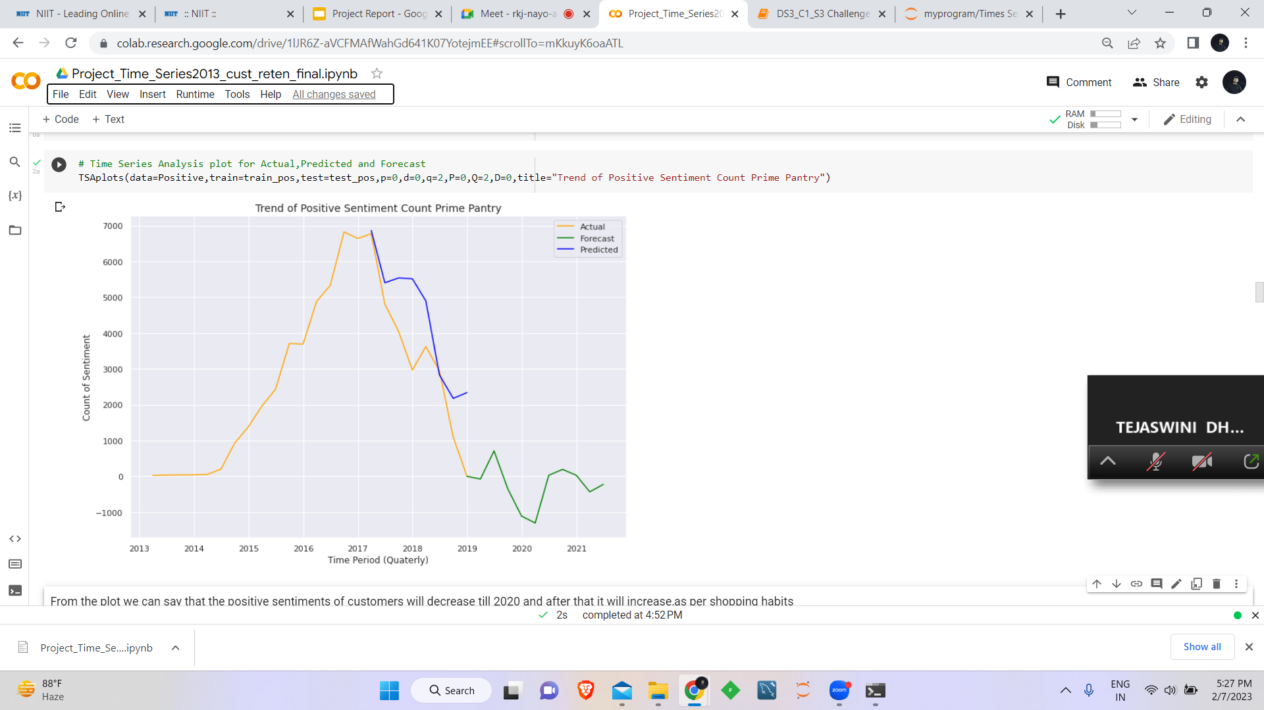
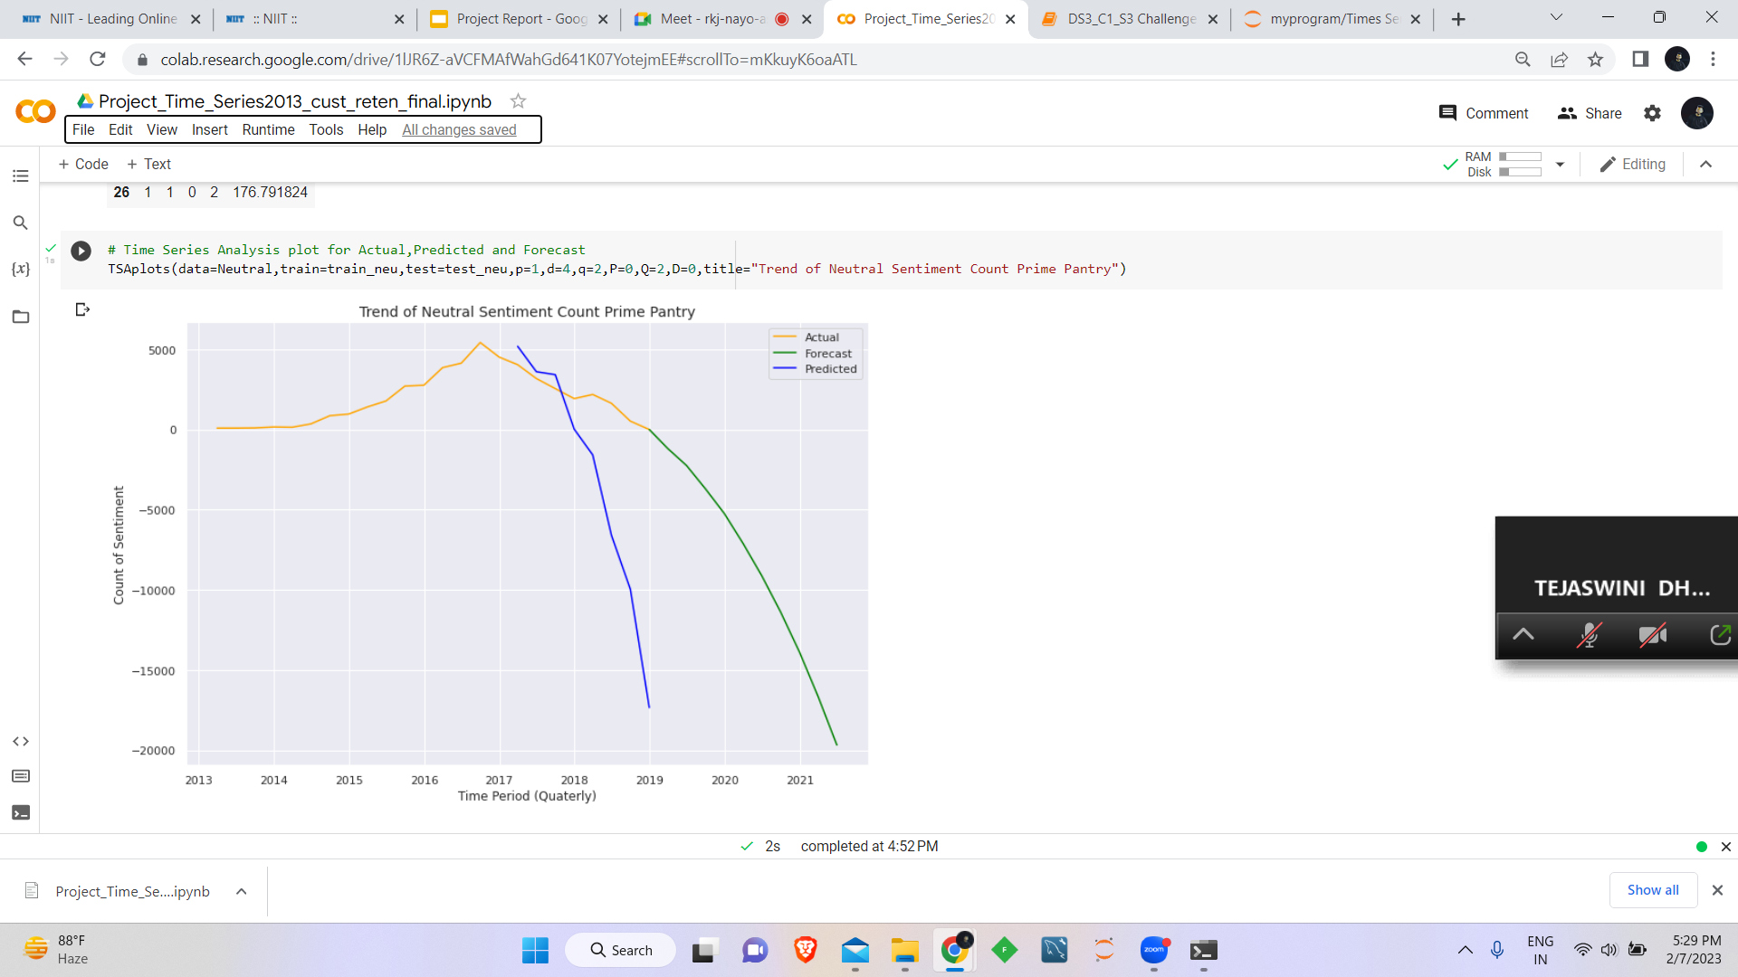
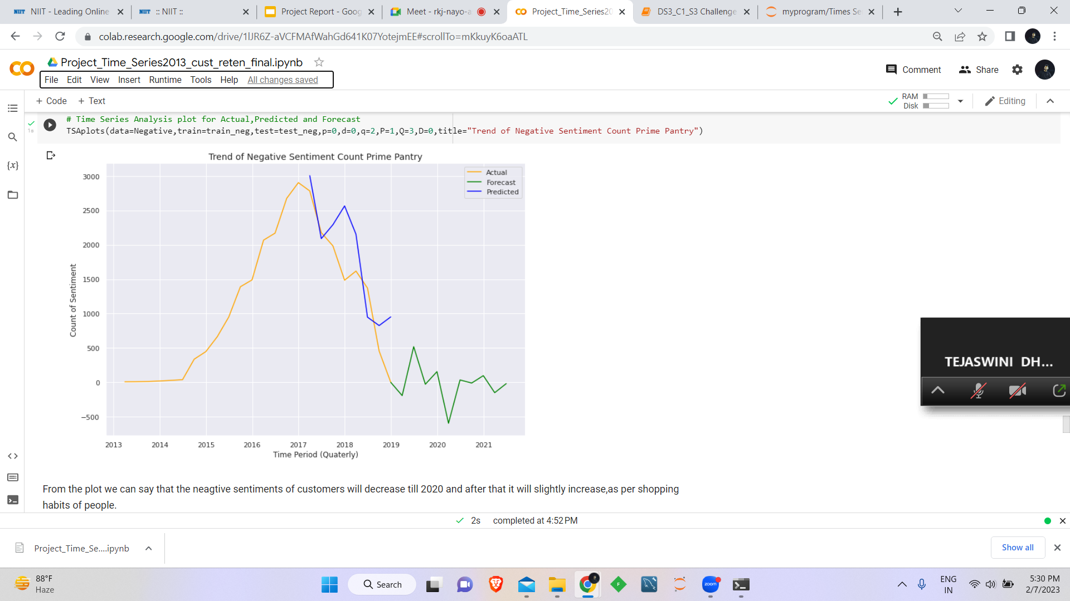
Sentiments Forecasting
Positive Sentiment Forecasting | Neutral Sentiment Forecasting | Negative Sentiment Forecasting
SARIMA[(p=0,d=0,q=2,P=0,Q=2,D=0)] | SARIMA[(p=1,d=4,q=2,P=0,Q=2,D=0)] | SARIMA[(p=0,d=0,q=2,P=1,Q=3,D=0)]
From the plot we can say that the positive sentiments of customers will decrease till 2020 and after that it will increase, as per shopping habits of people.
From the plot we can say that the neutral sentiments of customers will gradually decrease ,as per shopping habits of people.
From the plot we can say that the negative sentiments of customers will first increased after that it will decrease till 2020 and after that it will again slightly increase, as per shopping habits of people.

Slide 21
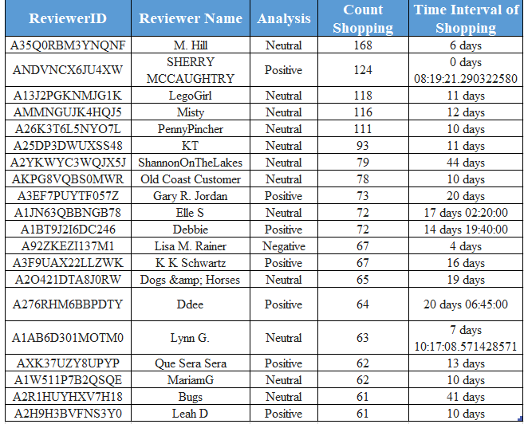
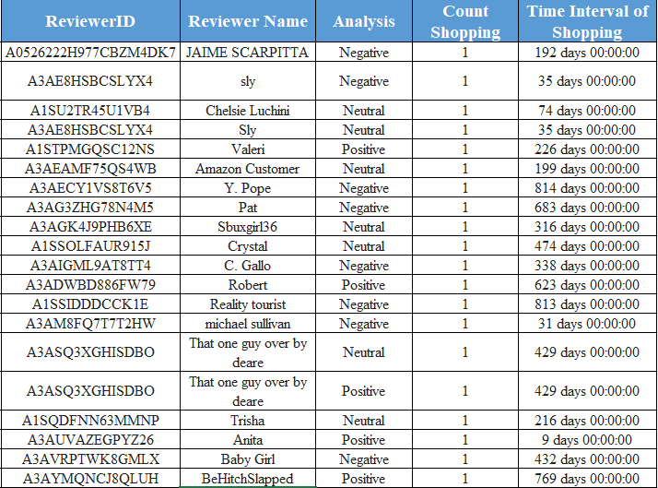
Conclusion
Customer we should focus on:
Customer would likely to Churn out:

Slide 22
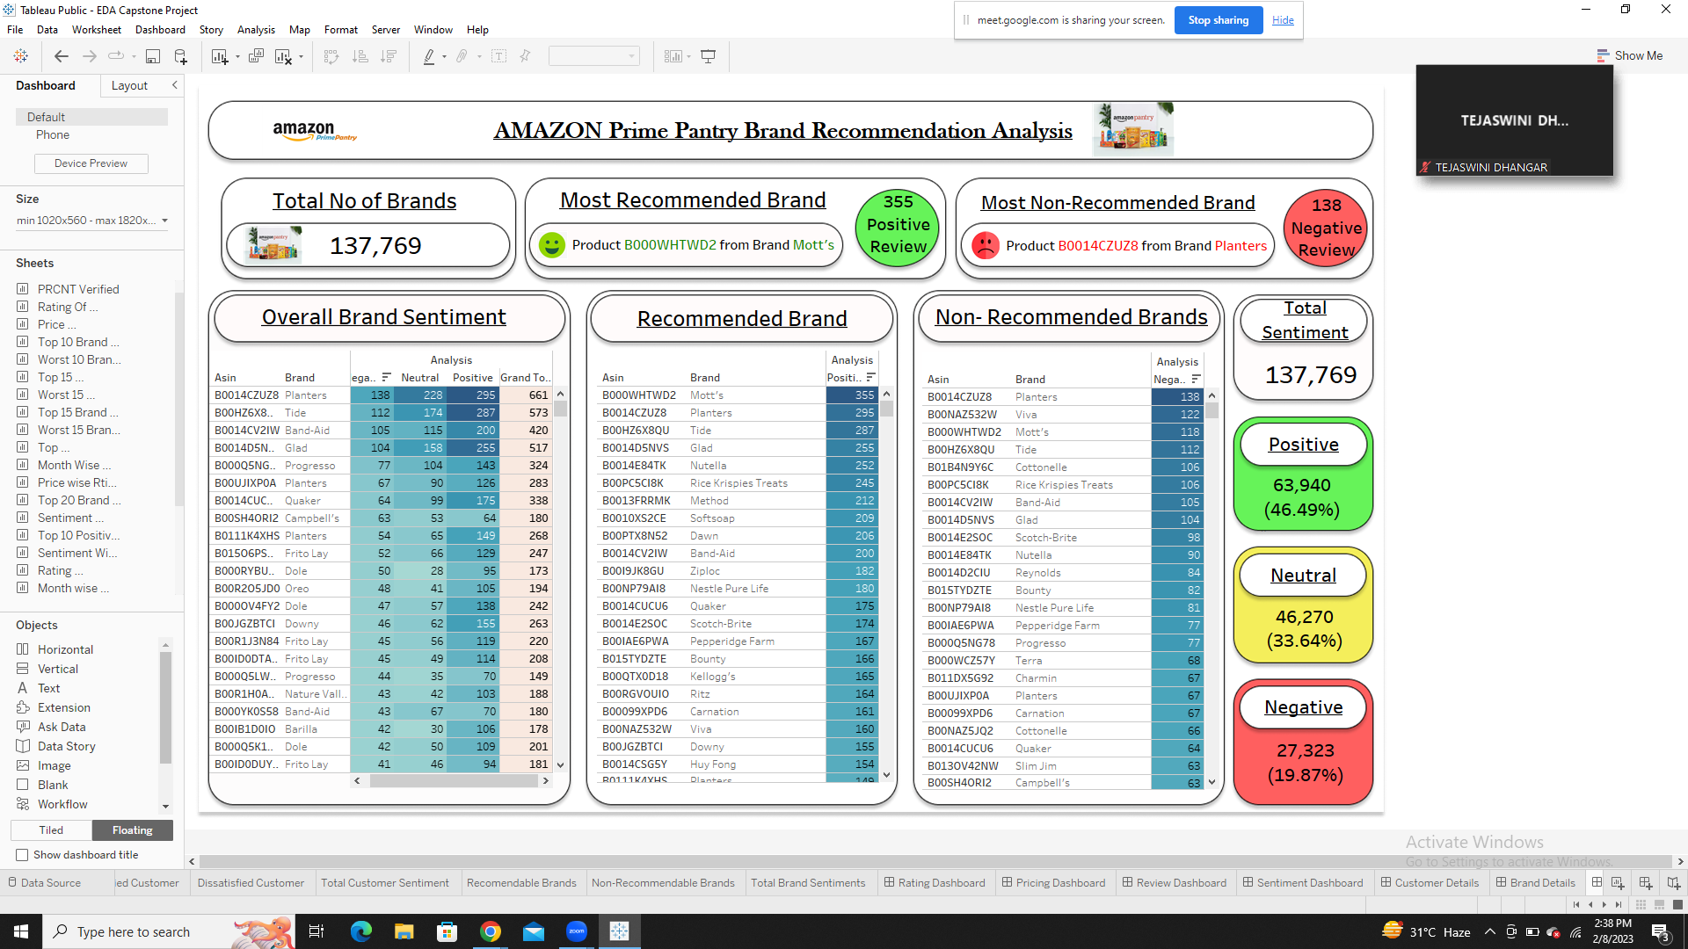
Conclusion(Contd.)

Slide 23
Business Insights
We will recommend our classification model to predict the sentiments of the reviews related to prime pantry products.
We will recommend our clustering model to identify in which cluster the new customers will fall based on their shopping habits.
The positive sentiments of customers will decrease till 2020 and after that it will increase. So we can suggest the products from various brands that got moderate to low rating, try to improve the quality of the products so that the positive reviews remain constant or increase gradually.

Slide 24
Business Insights (Contd.)
The neutral sentiments of customers will gradually decrease. So we may say that the neutral reviews will move towards either positive or negative reviews. So we can suggest the products from the brands that got the neutral reviews more, upgrade the quality or sales so that it will move towards positive reviews more.
The negative sentiments of customers will decrease till 2020 and after that it will slightly increase. So we will recommend to increase the advertisements, simultaneously improve the quality of product and sales so that more people will buy those products & give more number of reviews.

Slide 25
Thank You

